Slide 1






Image Caption Generator
TEAM MEMBERS MANEESHA Y(1005-21-733-033) NIHARIKA RODDA(1005-21-733-
043)

Slide 2


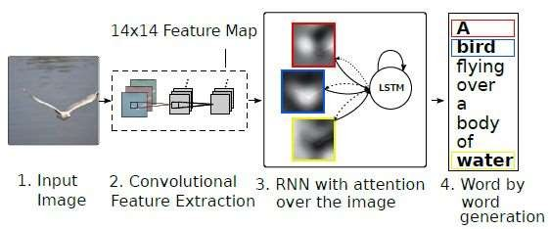
Problem Statement:
Implementing attention-based models for generating descriptive captions for images, focusing on salient regions and objects in
the image.
This can be done using Convolutional Neural Networks (CNN) and Long short-term memory (LSTM) together

Slide 3
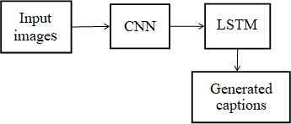
Methods Used:
Convolutional Neural Networks (CNN) - CNN is a subfield of Deep learning and specialized deep neural networks used to recognize and classify images. It processes the data represented as 2D matrix-like images. CNN can deal with scaled, translated, and rotated imagery. It analyzes the visual imagery by scanning them from left to right and top to bottom and extracting relevant features. Finally, it combines all the parts for image classification
Long short-term memory (LSTM) - Being a type of RNN (recurrent neural network), LSTM (Long short-term memory) is capable of working with sequence prediction problems. It is mostly used for the next word prediction purposes, as in Google search our system is showing the next word based on the previous text. Throughout the processing of inputs, LSTM is used to carry out the relevant information and to discard non- relevant information.
Image Caption Generator Model (CNN-RNN model) = CNN + LSTM
CNN – To extract features from the image. A pre-trained model
called VGG-16 is used for this.
LSTM – To generate a description from the extracted
information of the image.

Slide 4
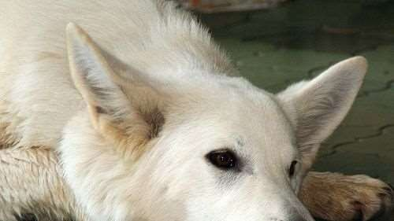

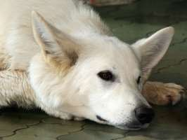
Dataset:
Flickr8k Dataset:
8091 images
5 captions for each image.
Caption1: closeup of white dog that is laying its head on its paws
Caption 2: large white dog lying on the floor
Caption 3: white dog has its head on the ground
Caption 4: white dog is resting its head on tiled floor with its eyes open
Caption 5: white dog rests its head on the patio bricks

Slide 5








Cleaning the caption data
Extracting features from images using VGG-
16
Flow of the project
c. Merging the captions and images
d. Building LSTM model for training
e. Predicting on test data
f. Evaluating the captions using BLEU scores as
the metric

Slide 6
Steps to follow:
1. Cleaning the captions
This is the first step of data pre-processing. The captions contain regular expressions, numbers and other stop words which need to be cleaned before they are fed to the model for further training. The cleaning part involves removing punctuations, single character and numerical values. After cleaning we try to figure out the top 50 and least 50 words in our dataset.
2. Adding start and end sequence to the captions
Start and end sequence need to be added to the captions because the captions vary in length for each image and the model has to understand the start and the end.
3. Extracting features from images
After dealing with the captions we then go ahead with processing the images. For this we make use of the pre-
trained VGG-16 weights.
Instead of using this pre-trained model for image classification as it was intended to be used. We just use it for extracting the features from the images. In order to do that we need to get rid of the last output layer from the model. The model then generates 4096 features from taking images of size (224,224,3).
4. Viewing similar images
When the VGG-16 model finishes extracting features from all the images from the dataset, similar images from the clusters are displayed together to see if the VGG-16 model has extracted the features correctly and we are able to see them together.

Slide 7
5. Merging the caption with the respective images
The next step involves merging the captions with the respective images so that they can be used for training. Here we are only taking the first caption of each image from the dataset as it becomes complicated to train with all 5 of them.
Then we have to tokenize all the captions before feeding it to the model.
6. Splitting the data for training and testing
The tokenized captions along with the image data are split into training, test and validation sets as required and are then pre-processed as required for the input for the model.
7. Building the LSTM model
LSTM model is been used beacuse it takes into consideration the state of the previous cell's output and the present
cell's input for the current output. This is useful while generating the captions for the images.
The step involves building the LSTM model with two or three input layers and one output layer where the captions are generated. The model can be trained with various number of nodes and layers. Various hyperparameters are used to tune the model to generate acceptable captions
•
8. Predicting on the test dataset and evaluating using BLEU scores
After the model is trained, it is tested on test dataset to see how it performs on caption generation for just 5 images. If the captions are acceptable then captions are generated for the whole test data.

Slide 8



Define the CNN-RNN model
From the Functional API, we will use the Keras Model in order to define the
structure of the model. It includes:
Feature Extractor –With a dense layer, it will extract the feature from the images of
size 2048 and we will decrease the dimensions to 256 nodes.
Sequence Processor – Followed by the LSTM layer, the textual input is handled by
this embedded layer.
Decoder – We will merge the output of the above two layers and process the dense
layer to make the final prediction.
The Process:
Data Preparation: A large dataset of images with corresponding captions is required. This trains the model to recognize the relationship between visual features and appropriate language descriptions.
Feature Extraction: The CNN takes an image and extracts a set of features that
represent its visual content.
Sequence Prediction: The LSTM network receives the extracted features and starts generating a caption word by word. It considers the previously generated words and the image features to predict the next word in the sequence. This continues until a complete caption is formed.

Slide 9
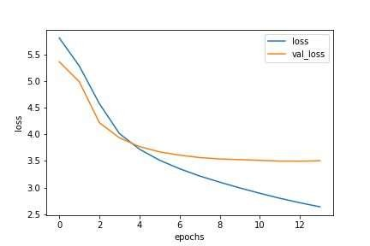
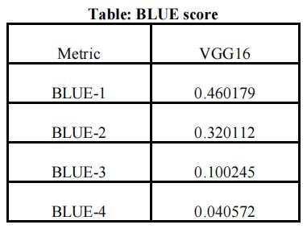
Fit Model:
6 epochs
32 batch size
Training loss is decreasing as we increase
the number of epochs.
Evaluation:
Bleu score in Python is a metric that measures the goodness of Machine Translation models.
The BLEU score compares a sentence against one or more reference sentences and tells how well does the candidate sentence matched the list of reference sentences. It gives an output score between 0 and 1.
A BLEU score of 1 means that the candidate sentence perfectly matches one of the reference sentences.

Slide 10

BLEU SCORE
BLEU Score | Interpretation
< 10 | Almost useless
10 - 19 | Hard to get the gist
20 - 29 | The gist is clear, but has significant grammatical errors
30 - 40 | Understandable to good translations
40 - 50 | High quality translations
50 - 60 | Very high quality, adequate, and fluent translations
> 60 | Quality often better than human

Slide 11

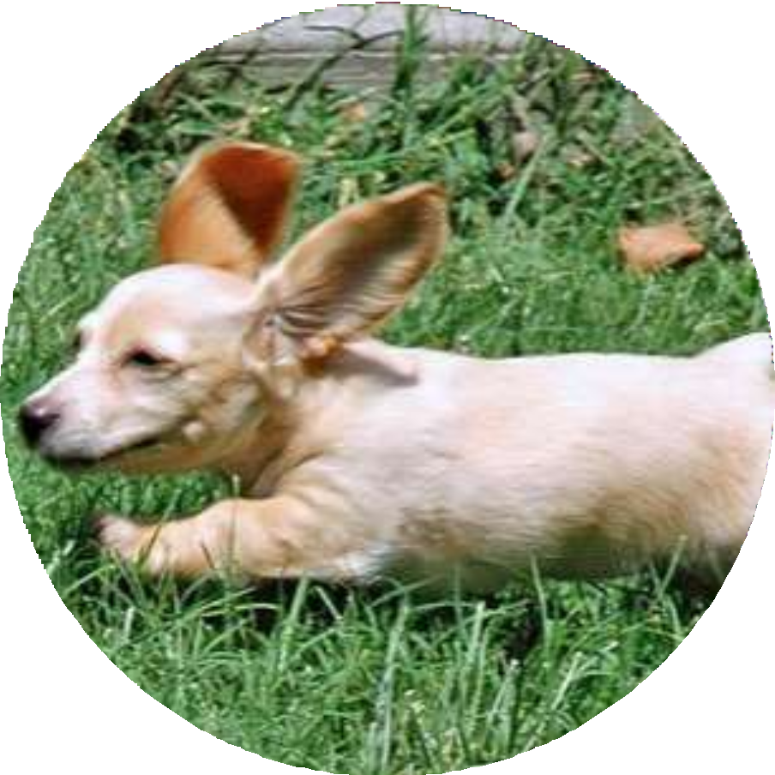





Result
OUTPUT

